Slide 1

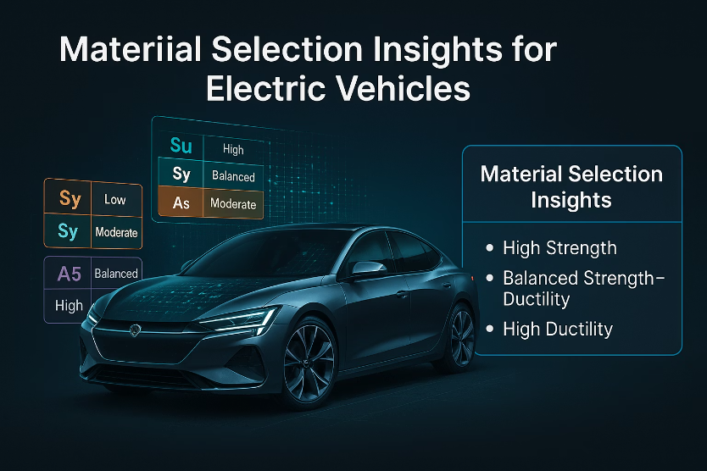


Slide 2

Material Selection Insights for Electric Vehicles
Engineering-Based Evaluation from Mechanical and Environmental Data
This presentation explores critical findings from analyzing over 1,500 materials focused on strength, ductility, hardness, and environmental resilience. We provide data-driven recommendations for materials optimal in electric vehicle (EV) components, balancing mechanical performance and sustainability. Real-world applications underscore the engineering relevance of selected materials and heat treatment effects on their properties.

Slide 3
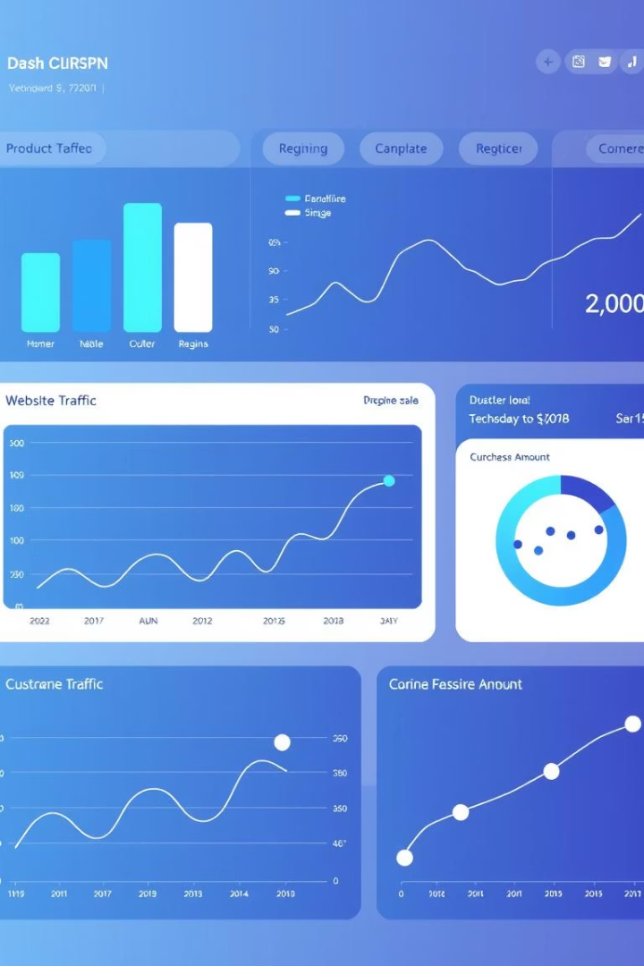
Project Scope & Dataset Summary
Scope
Analysis covers 1,552 unique materials evaluated through six tasks focusing on mechanical and environmental criteria.
Key Focus Areas
Strength, ductility, and hardness
Heat treatment responses and corrosion resistance
Elastic modulus and density properties
This extensive dataset allows us to identify performance trends and material clusters suitable for various EV design challenges while ensuring durability under operational stresses.

Slide 4
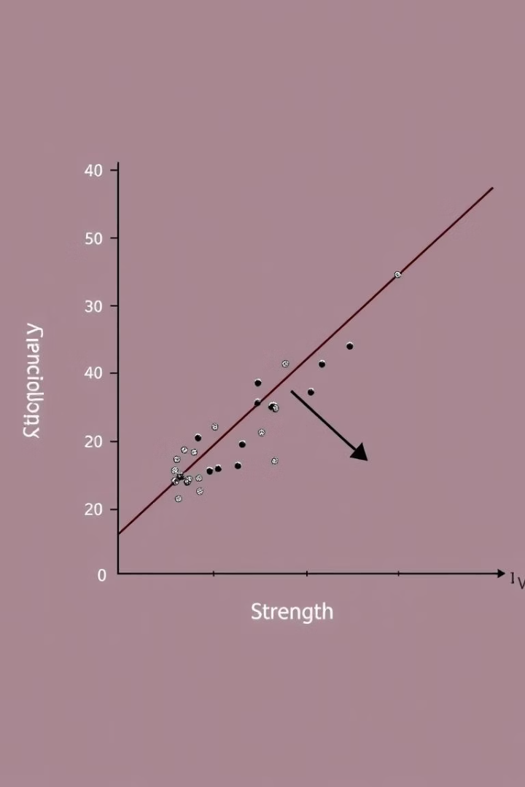



Mechanical Property Landscape
Strength Range
Tensile strength (Su) varies broadly from 179 to 1226 MPa after eliminating extreme outliers.
Ductility Range
Elongation at fracture (A5) spans from 4% to 45%, indicating material deformability potential.
Trade-Off Insight
High strength often decreases ductility, raising brittleness risks. Materials near Su=500 MPa and A5=16% offer a balanced compromise.

Slide 5
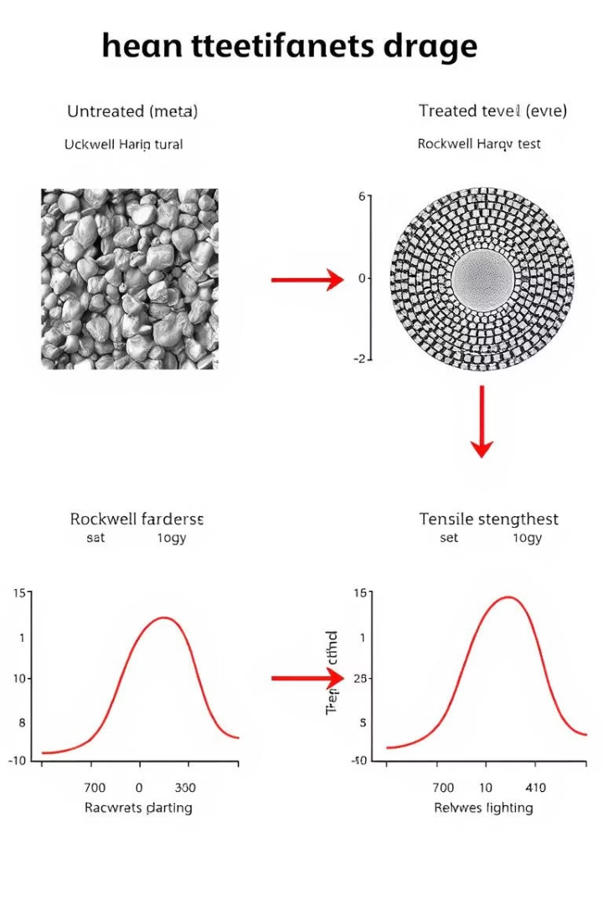
Heat Treatment Impacts
Property Shifts
Example: SAE 1030 Steel
Heat treatment significantly alters strength and ductility profiles, optimized per application.
As-rolled condition yields Su=552 MPa with 32% elongation; tempering increases strength to 848 MPa but reduces ductility to 17%.
Design Implications
Selective heat treatment can tailor materials for specific load and deformation requirements in EV parts.

Slide 6
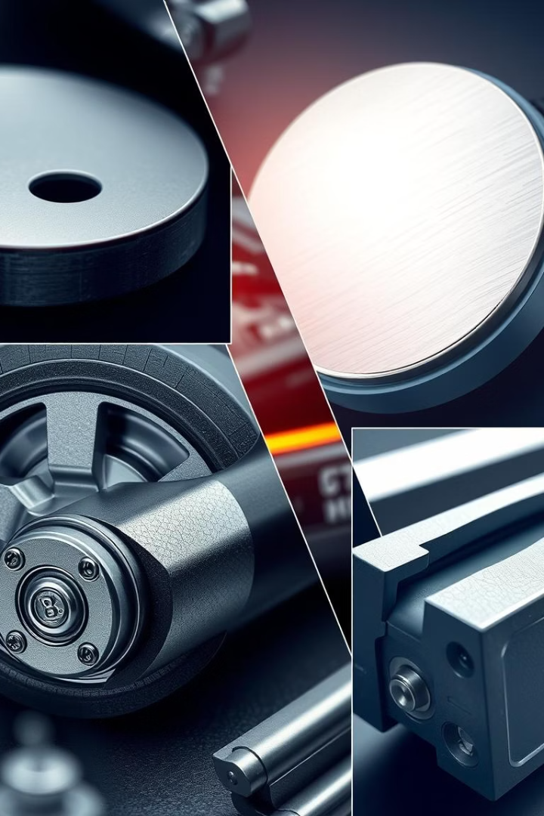
Top Materials by Use Case
Wear Resistance
SAE 8640 (Nitro-case hardened)
High Load
CSN 16640 (Tempered at 800°F)
Forming
Aluminum 1060-O (High tensile and Brinell hardness)
Energy Absorption
SAE 30301 (Highest Su × A5 = 34,110 MPa%)
Lightweight Design
7075-T6 Aluminum (High strength-to-density ratio Su/ρ = 0.212)
This table links key materials to their ideal electric vehicle applications, enabling focused engineering selection for component performance optimization.

Slide 7




Strength-Based Design Ratios
Su/Bhn
Su × A5
Su/ρ
Reflects machinability and hardness correlation
Composite toughness indicator balancing strength and ductility
Measures strength-to-weight ratio for lightweight design optimization
No single material dominates all metrics; trade-offs necessitate prioritization based on component function.

Slide 8
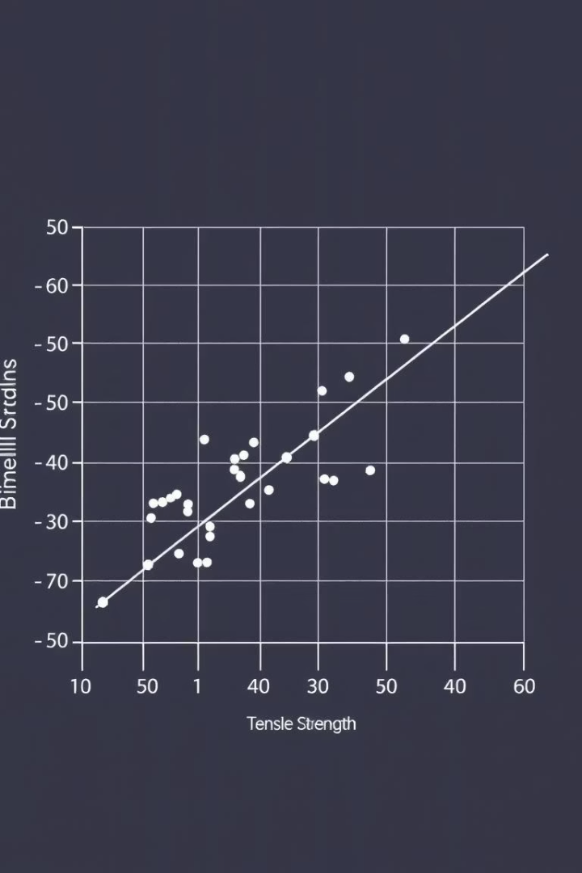
Hardness as a Selection Proxy
Brinell Hardness (Bhn)
Vickers Hardness (HV)
Strong correlation with tensile strength (R=0.90) and yield strength (R=0.87), making it a reliable strength predictor.
Moderate correlation with strength and ductility trade-off (Su/Sy R moderate, A5 correlation negative)
Design Recommendation
Use Brinell hardness for quick strength estimation and Vickers hardness for surface property evaluation in wear-prone areas.

Slide 9

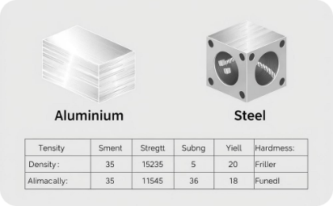
Elasticity & Deformability in Design
Elastic Modulus & Isotropy
Key Material Properties
Aluminum: E ≈ 73 GPa, Poisson’s ratio ≈ 0.32
Elastic modulus (E) correlates closely with shear modulus (G), confirming isotropic material behavior for accurate design modeling.
Steel: E ≈ 200 GPa, Poisson’s ratio ≈ 0.29
Use elastic modulus as the primary stiffness metric for performance prediction.

Slide 10
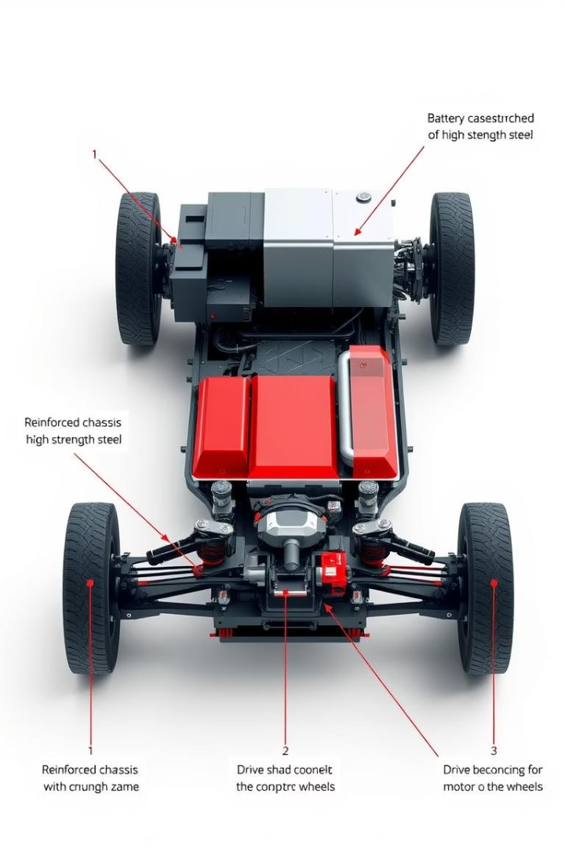
Material Selection by Application
Battery Case
Steel SAE 30310 (Optimized corrosion & ductility)
Chassis Frame
Aluminum 7075-T6 (High strength-to-weight ratio)
Crash Structures
Aluminum 2024-T4 (Superior energy absorption Su × A5)
Shafts & Gears
SAE 8640 (Hardness and tensile strength optimized)
This application-specific mapping ensures tailored material properties to critical EV components for performance, safety, and weight reduction.

Slide 11

Final Engineering Takeaways
Data Limitations
Elastic & Hardness Metrics
Current dataset quality constrains confidence at extreme property ranges; further refinement needed.
Heat Treatment
Material Suitability
A key lever to dramatically enhance or tailor mechanical properties for targeted applications.
Support isotropic design assumptions and enable rapid screening for strength and surface wear selection.
No one-size-fits-all material exists; prioritize performance ratios aligned with specific EV component demands.

Slide 12

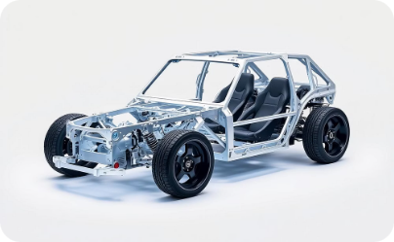
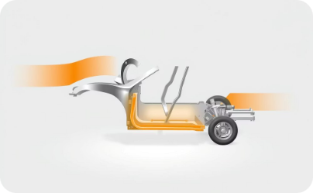
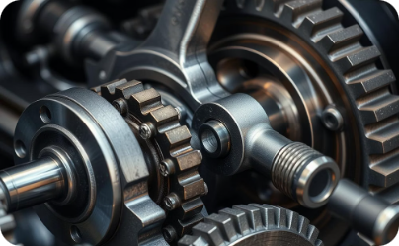
Real-World Applications for Best-Ranked Materials
Battery Case
Chassis Frame
Crash Structures
Shafts & Gears
Steel SAE 30310 offers corrosion resistance and ductility for battery protection.
Aluminum 7075-T6 balances high strength and low weight for vehicle frames.
Aluminum 2024-T4 excels in energy absorption for safety-critical zones.
SAE 8640 steel optimizes hardness and tensile strength for drivetrain components.

Slide 13
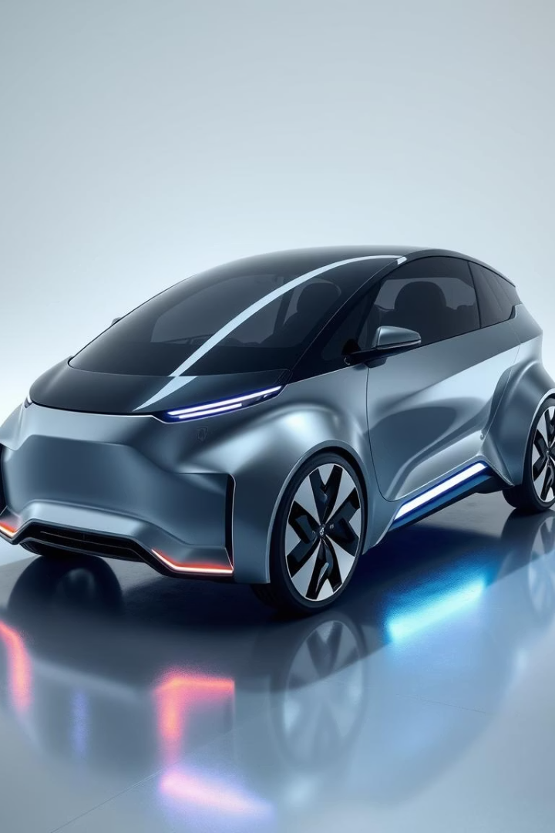
Future Trends
Emerging materials and technologies will redefine EV design and performance.
Focus on lighter, stronger alloys and advanced heat treatments enhances efficiency.
Integration of sustainability and recyclability becomes essential in material selection.

Slide 14

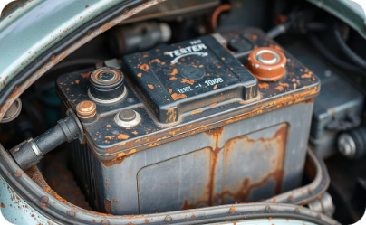
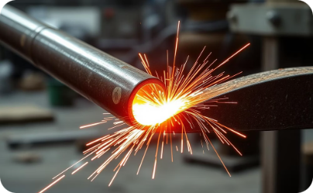
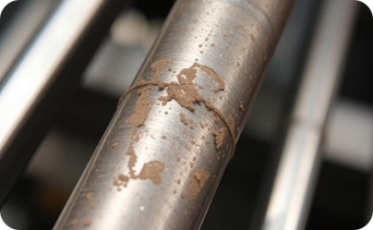
Failure Modes in EV Materials
Fatigue Failure
Corrosion Damage
Thermal Stress
Wear and Abrasion
Repeated stress cycles cause cracks and fractures.
Environmental exposure degrades battery cases.
Heat fluctuation leads to expansion and contraction.
Surface hardness affects friction resistance in drivetrain parts.

Slide 15



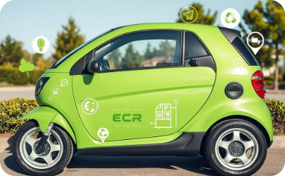
Sustainability Metrics
Recyclability
Carbon Footprint
Resource Availability
Balanced Evaluation
Effectively recovering and reusing materials to reduce waste and conserve resources.
Total greenhouse gas emissions during material production, use, and disposal.
Abundance and accessibility of raw materials affecting sustainability and cost.
Combining environmental and economic factors to guide sustainable material choices.

Slide 16

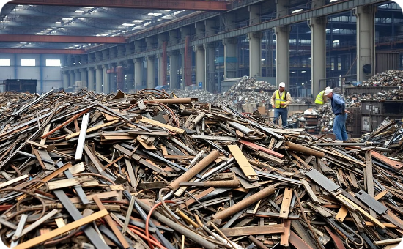

Recycling Strategies in EV Materials
Aluminum Recycling
Steel Reclamation
Battery Material Recovery
High recyclability reduces energy usage and carbon footprint in EV frames.
Steel components like chassis and gears benefit from established recycling streams.
Recovering lithium and cobalt minimizes environmental impact and resource scarcity.

Slide 17
Material Testing Process
1
2
3
4
Sample Preparation
Mechanical Testing
Thermal Analysis
Data Analysis
Specimens are cut and polished to standard dimensions.
Tensile, hardness, and fatigue tests evaluate key properties.
Heat treatments and thermal cycling assess stability and performance.
Results guide material selection for EV component optimization.

Slide 18
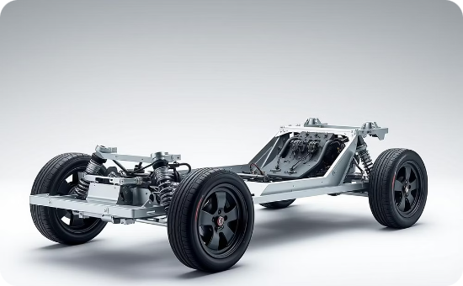

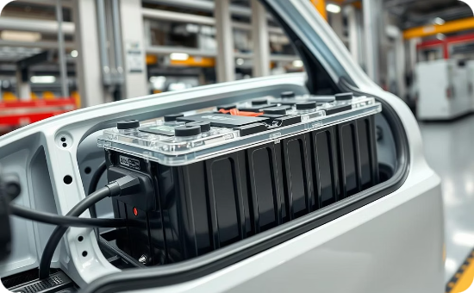
Lightweighting Strategies in EV Design
Advanced Materials
Design Optimization
Integrated Components
Using aluminum alloys and carbon fiber composites reduces overall weight.
CAD and simulation tools help minimize material use without sacrificing strength.
Combining functions reduces part count and saves weight in EV modules.

Slide 19
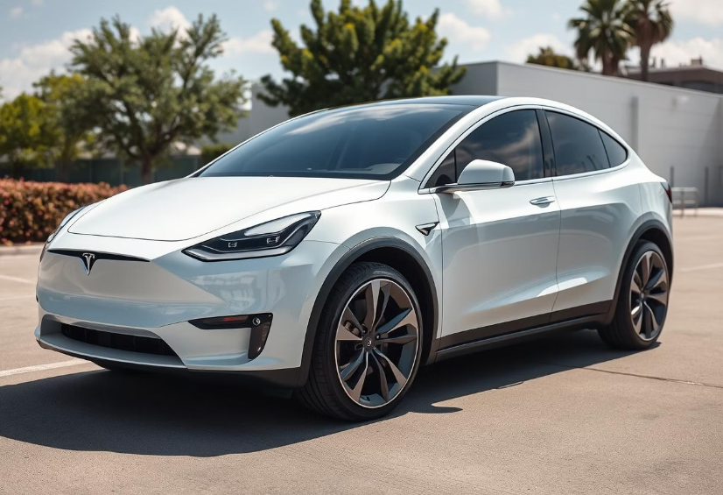
Case Study: Tesla Electric Vehicle
The Tesla EV showcases advanced material selection for high performance.
Aluminum alloys reduce chassis weight, improving driving range.
Battery enclosures use composites for thermal management and safety.
High-strength steel enhances structural integrity in safety-critical parts.

Slide 20
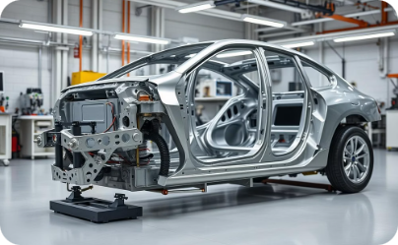
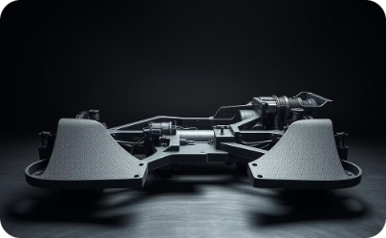
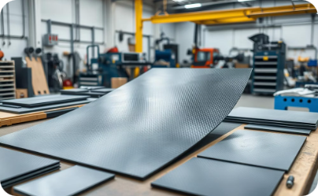
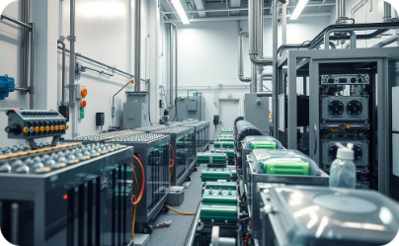
Material Alternatives Explored
Aluminum Alloys
High-Strength Steel
Carbon Fiber Composites
Battery Materials
Lightweight and corrosion-resistant, ideal for EV frames and body panels.
Offers enhanced safety and durability for structural and safety-critical parts.
Recovered lithium and cobalt support resource efficiency and environmental goals.
Exceptional strength-to-weight ratio used in battery enclosures and performance modules.

Slide 21

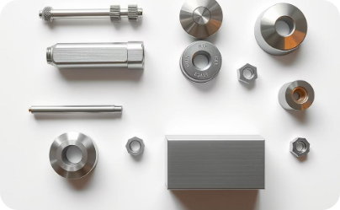


Emerging Materials in EV Design
Solid-State Batteries
Magnesium Alloys
Graphene Composites
Bio-Based Composites
Safer, with higher energy density, these batteries promise longer range and faster charging.
Ultra-lightweight and strong, ideal for reducing overall vehicle weight and boosting efficiency.
Exceptional conductivity and strength support enhanced battery performance and structural applications.
Eco-friendly materials reduce environmental impact while maintaining performance standards in EV parts.

